Slide 1
G. D. Thorat
Assistant Professor
Shri Shivaji Science & Arts College Chikhli, Dist. Buldana
Aldehyde

Slide 2
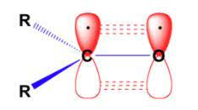
Aldehyde
Structure of Carbonyl Group

Slide 3
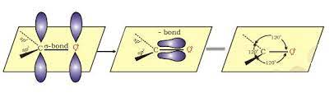
Structure of Carbonyl Group
Bond Angle 120
Dipole Moment 2.3 to 2.8 D

Slide 4
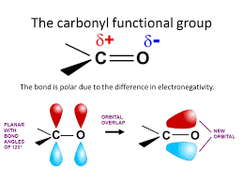
Carbonyl Group

Slide 5
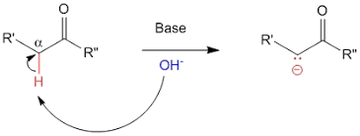
Acidity of α-Hydrogen in Carbonyl Compound
Acidity of α-Hydrogen in Carbonyl Compound is More.
Electro negativity of H=2.1, C=2.5, O=3.5

Slide 6
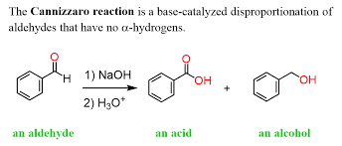
Cannizzaro Reaction

Slide 7
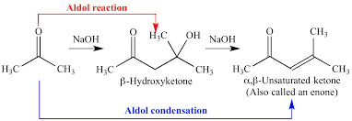
Aldol Condensation of Ketone

Slide 8
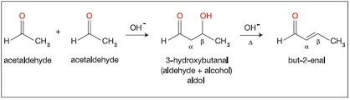
Aldol Condensation of Aldehyde

Slide 9
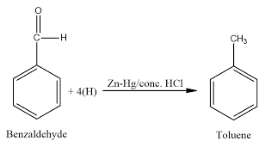
Clemmesen Reduction of Aldehyde

Slide 10
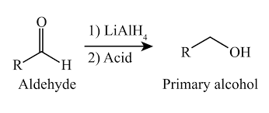
Reduction of Aldehyde by LiAIH4

Slide 11


