Slide 1
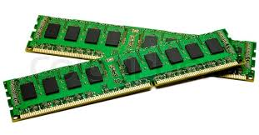

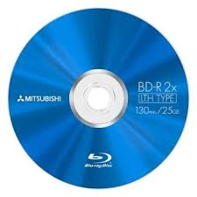

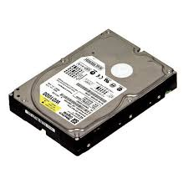
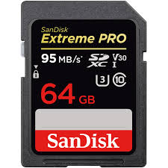

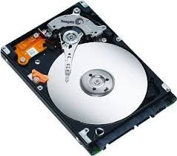
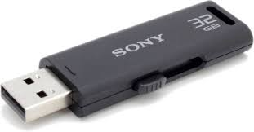
Types of Memory
Primary Memory
Types of Primary Memory
RAM- Random Access Memory
SRAM- Static Random Access Memory
DRAM- Dynamic Ramdom Access Memory
Read only Memory-
PROM- Programmable Read Only Memory
EPROM- Erasable Programmable Read Only Memory
EEPROM- Electrically Erasable Programmable Read Only Memory
Secondary Memory-
Types of Secondary Memory
Hard Disk
Optical Disk
Pendrive
Memory Card
Data Card
Blue Ray Disc

