Slide 1
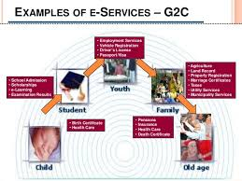
Government-to-Citizen
Government
Website
Citizen
www.maharashtra.gov.in
www.mahapwd.com
www.nagpur.gov.in
www.mahatranscom.in
www.msrtc.gov.in
www.punecorporation.org
www.maharashtratourism.gov.in
www.mahaagri.gov.in
www.bombayhighcourt.nic.in
www.mahapolice.gov.in
www.maha-arogya.gov.in
www.ceomaharashtra.gov.in
www.mahabhulekh.maharashtra.gov.in

Slide 2
Business Organisation
Website
Government
www.maharashtra.gov.in
www.incometaxindia.gov.in
www.gst.gov.in
www.mahapwd.com
www.maharashtraetenders.in
www.pwdmaharashtraetender.in
www.eauction.gov.in
www.incometaxindiaefiling.gov.in
www.shopactregistration.org
Name of the B2G Websites in India

Slide 3
Government
Website
Citizen
Name of the B2G Websites in India

